Slide 1

What is synthesis? Socio-environmental synthesis?

Slide 2
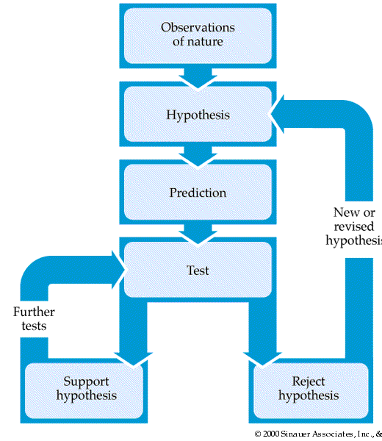
Notes:
This slide will allow us to talk about the scientific method and how it applies to both social sciences and natural sciences and how it differs

Slide 3
Notes:
This will allow us to talk about different levels of cognition

Slide 4
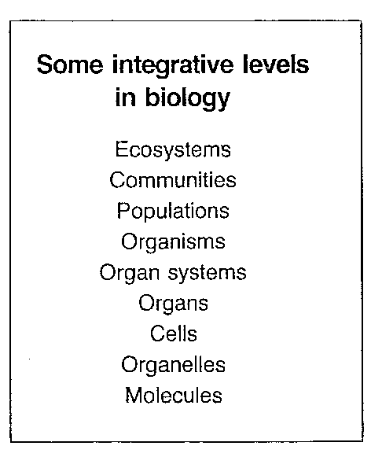
Bartholomew 1986
Notes:
This is a start to synthesis… within a discipline (allow to discuss Barth).

Slide 5
“The molecular biologists apt to feel that all the central problems will be solved at molecular or cellular levels, while the ecologist is apt to feel that students of molecules and cells are so preoccupied with details of cellular machinery that they are unaware of or indifferent to its consequences at the all-important organismic and population levels.” – Bartholomew (1986)

Slide 6
“With ignorance comes intolerance and lack of respect for unfamiliar areas, creating an enormous hazard for biology, at present and for the foreseeable future” – Bartholomew (1986)
“Training in synthesis conveys the ability to consense the essential points from one’s own discipline, work constructively with diverse experts, respect diverse ways of knowing and kinds of knowledge, recognize and distill patterns from complexity, and explain synthetic findings to policy makers and other stakeholders.” – Carpenter et al. (2009)

Slide 7
How to allocate scarce resources
toward alternative desirable ends?
Bridging Disciplines
Transdiscipline
Philosophy
Ethics
Neurosciences
Neuroeconomics
Behavioral Sciences
Behavioral economics
Economics
Institutional economics
Ecological Economics
Political Science
Experimental economics
Sociology
Anthropology
Evolutionary economics
Life Sciences
Earth Sciences
Erikson 2012
Notes:
Example in social sciences

Slide 8
Notes:
Bringing it all together….

Slide 9
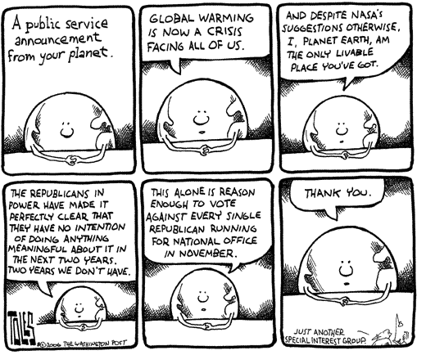
Class exercise: Systems Map
Does climate change have an impact on our current lives?
Notes:
Notes: In this exercise we want to introduce several elements: system map – what is it?; discuss different approaches of different disciplines; normative claims; quality and type of data

Slide 10

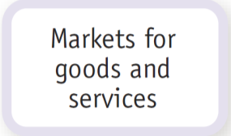
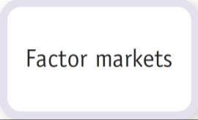

Transactions: The Circular-Flow Diagram
Money
Money
Goods and services
Factors
Trade in physical things such as goods, services, labor, and raw materials flows in one direction…
…and the money that pays for these physical things flows in the opposite direction.
Goods and services
Factors
Money
Money
Notes:
Social science model

Slide 11
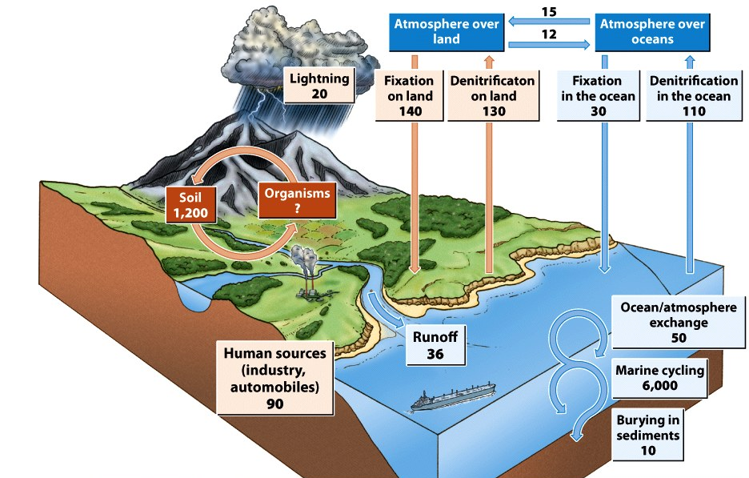
Notes:
Natural sciences model

Slide 12
Why is socio-environmental synthesis important? Actionable science
There are two approaches to developing research questions – what are they? And is one way better than another?
Actionable science is when “it has the potential to inform decisions (in government, business, and the household) to improve the design or implementation of public policies, or to influence public- or private-sector strategies, planning and behaviors that affect the environment.”

